Slide 1

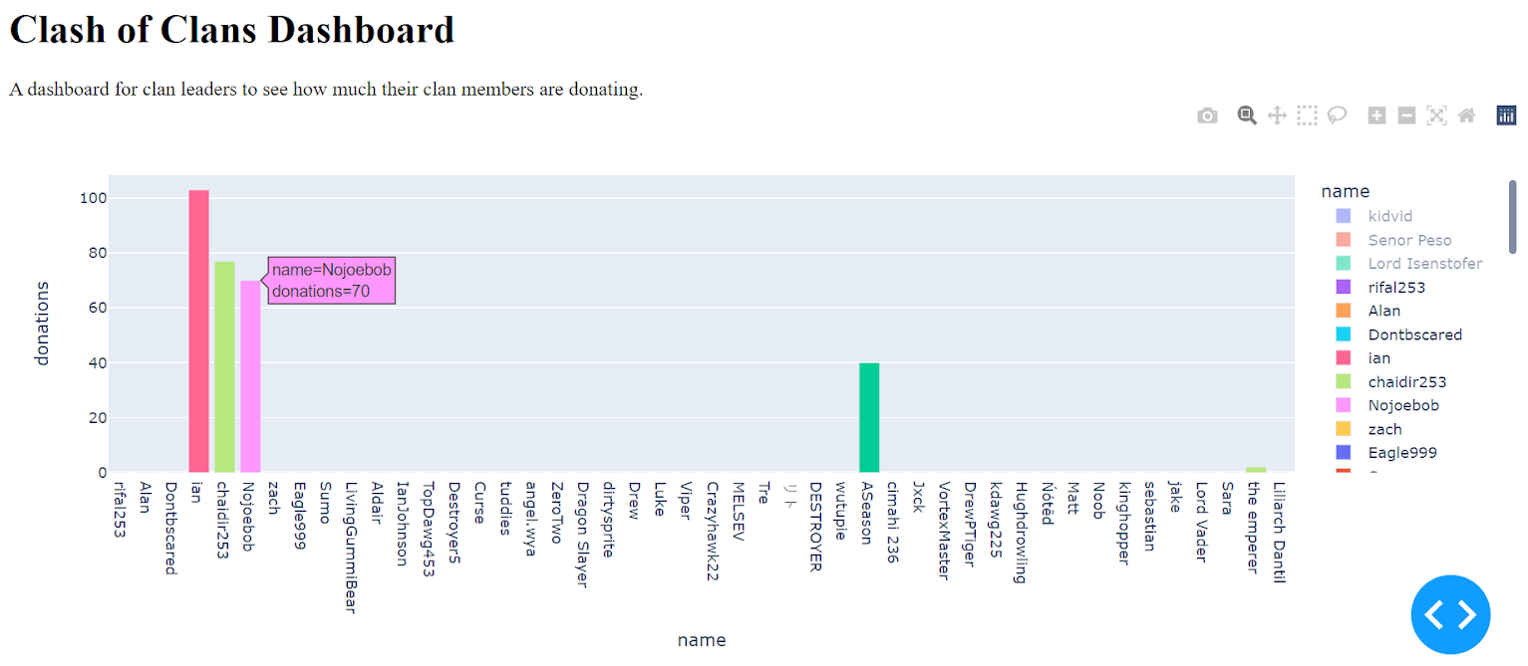
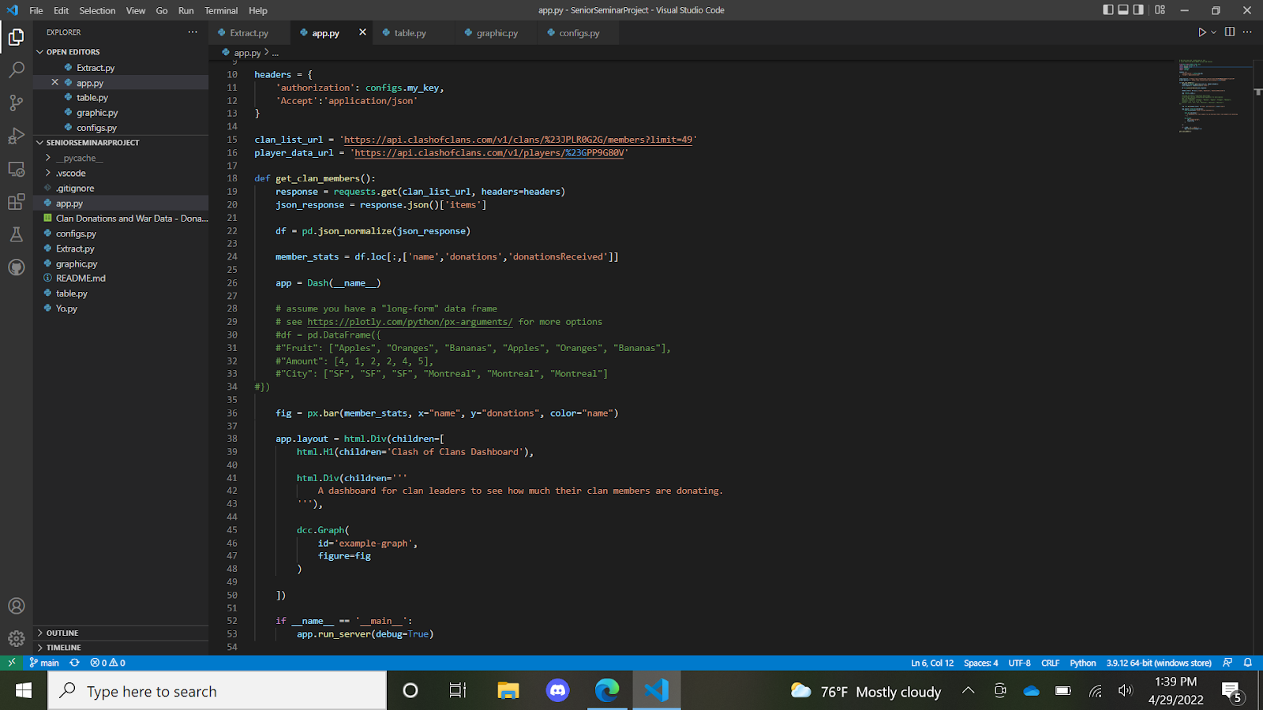
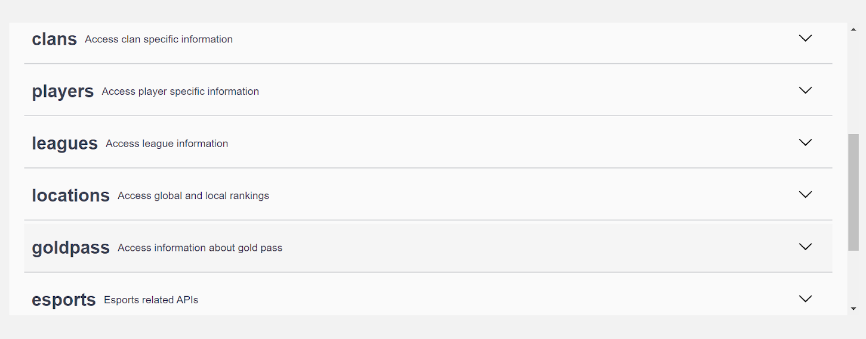
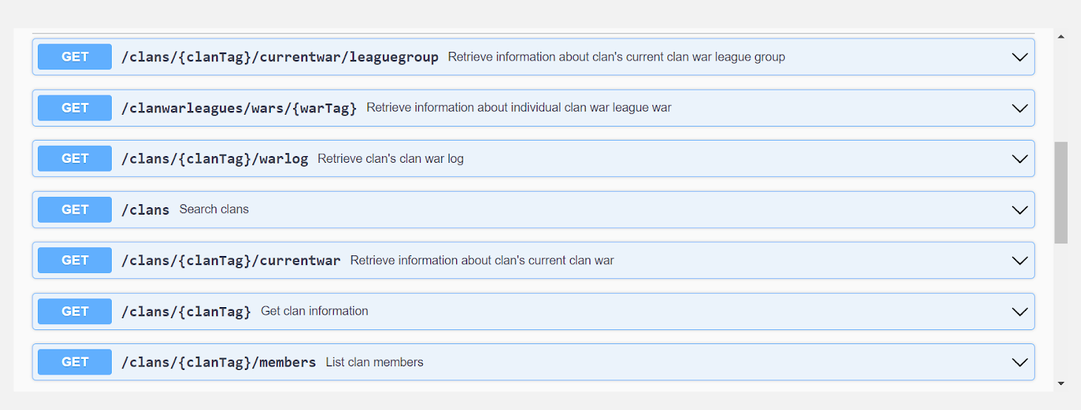
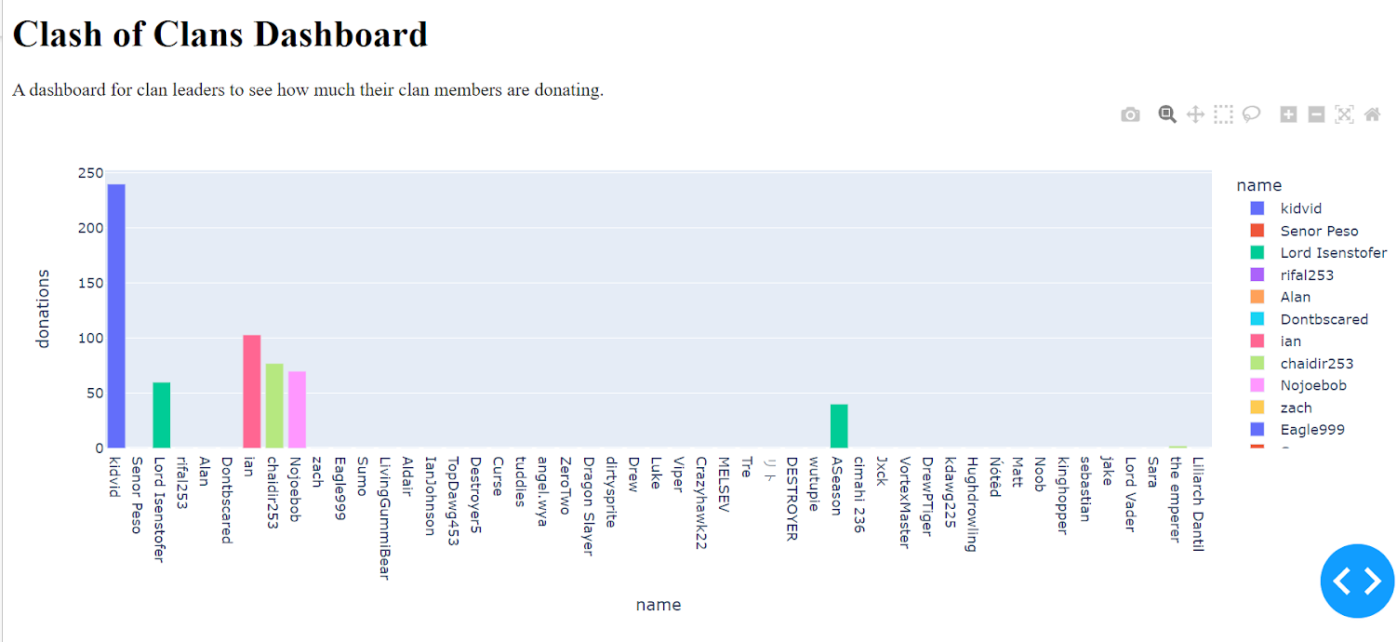
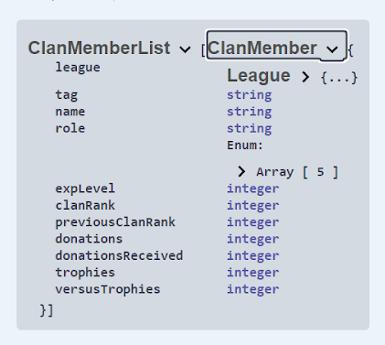
Clash of Clans Dashboard
Will Harper
Computer Science
Abstract
Methodology
Data Collection
The next screenshot is of an altered dashboard. I filtered out the top three clan members by clicking on their names in the key. Also, this shows the hover data that was added so you can quickly see stats.
This project is an attempt to create a Clash of Clans dashboard for Clan leaders to use in order to see their clan’s stats. It will consist of a dashboard, some Python programming, and the use of the Clash of Clans API. Connecting these three elements, the project should really help clan leaders in their efforts to manage their clans well.
To make this project a reality, I will be pulling from the Clash of Clans API in order to get accurate and live data about the game. I just make a few calls to their servers in order to retrieve the free data that they are providing. I will also be using Visual Studio Code’s Python IDE to create the data pipeline between the API and the dashboard. Lastly, I will be using Plotly’s dashboarding software to make the actual dashboard that will display the data.
I will be pulling from the Clash of Clans API in order to get accurate and live data about the game. I just make a few calls to their servers in order to retrieve the free data that they are providing.
Converting the Data
I will then be converting the data from raw data to CSV and then to something even more structured, perhaps like tables. Whatever the dashboard requires is what I want to convert the data into.
Background
Clash of Clans is a strategy-based mobile game that came out in 2012. Since then, it has retained an impressive player-base and is known for bringing people back to play it again and again. Even here in the Computer Science department, several students still play in a clan together, many of them for years. Clash of Clans is a game focused on teamwork. Clans have leaders who help direct them, but in order to do that, they need access to player stats that will help them see who is contributing to the clan and who is not. That way, they know who to trust with important tasks or ranks and who not to entrust those things. Clash of Clans does show many stats, but they refresh at the end of every month approximately. This proves difficult if a clan leader is trying to capture these stats to analyze who to ho should be put in what role. Often these roles are switched as players focus on different areas at different times. This dashboard gives leaders the ability to see all of a player’s stats. This dashboard visualizes the donation count since it is crucial in decision-making.
Here is a screenshot of my code:
Clash of Clans API
Displaying the Results
The API has many categories of data to pull from.
Lastly, I will be displaying the data in a Plotly dashboard which will have some nice sorting features for the clan leader using it. It should display the data nicely and simply in graph form and table form.
Results
Here are a couple screenshots of the results. This is a dashboard of only the donations. It is the most important statistic for a clan leader when deciding where to put people and whether to promote someone or not. This first screenshot shows the original dashboard, unaltered. There is a key, to the far right, with all the players. The bars on the graph visualize how many donations players have.
Under the “clans” category, there are several options.
Conclusion
Overall, the project was a success! I wish I could have added more graphs for the dashboard, but this was the only one that was numerically helpful to be graphed. I think the dashboard looks amazing though, and it runs excellently. There are also plenty of customizable options to change the graph to however the user prefers it. Now, the clan leader can easily access stats for his clan members.
Here are the different types of data sent if you call the “members” category.
Displaying the Results

